Slide 1
Adversarial Training : A Defense Mechanism
By
Deekshith Machidi - 2246684
Monish Kamal Batini - 2250471
Ajay Kumar Reddy Poreddy - 2247259
Vinay Kumar Posina - 2248768

Slide 2
Why Adversarial Training
Defense method to boost model resilience against adversarial attacks.
01
Purpose: Models are trained on both clean and adversarial perturbed data to recognize and resist manipulations.
02
Outcome: Enhanced robustness, protecting ML systems from malicious input that could lead to incorrect predictions.
03

Slide 3

Key Adversarial Attack Methods
Fast Gradient Sign Method (FGSM):
Creates adversarial examples by adding small perturbations in the gradient's direction.
Projected Gradient Descent (PGD):
Extends FGSM by applying multiple small perturbations iteratively, projecting back into the feasible region.
DeepFool and Carlini & Wagner (C&W) Attacks:
DeepFool: Minimizes the perturbation by iterating until misclassification occurs.
C&W: Known for high success rates against defensive models by minimizing a specialized objective function.

Slide 4
Adversarial Training Techniques
Standard Adversarial Training: Incorporates adversarial examples generated by a single attack (e.g., FGSM).
Pros: Simple and easy to implement.
Cons: May be overfit to the specific attack method.
Mixed Attack Adversarial Training: Trains with a mix of adversarial examples from different attack methods.
More robust to diverse attack methods, better generalization.
TRADES (Transferable Defense Strategy):Balances robustness and generalization by controlling the trade-off between clean and adversarial accuracy.

Slide 5
Implementation Workflow (Using PyTorch)
Step 1: Model Selection – Use robust architectures like ResNet or MobileNet for CIFAR-10.
1
Step 2: Attack Generation – Generate adversarial examples using methods like FGSM or PGD.
2
Step 3: Training Procedure:
3
Train the model on clean data.
Add adversarial examples to the training batch.
Fine-tune the model with both data types to improve robustness.
Step 4: Evaluation – Test model resilience to multiple adversarial attacks.
4

Slide 6

Case Study – Adversarial Training on CIFAR-10
Data: CIFAR-10 Dataset
Model: ResNet or MobileNet (pretrained)
Adversarial Training Setup:
Implement PGD and FGSM-based adversarial training on CIFAR-10.
Measure accuracy on clean and adversarial test sets.
Results:
Comparison of robust accuracy on standard vs. adversarial trained models.

Slide 7
Real-World Applications
Autonomous Vehicles:
Adversarial training helps detect and mitigate visual perturbations, improving safety.
Healthcare Diagnostics:
Enhances robustness in diagnostic models to adversarial medical image manipulation.
Financial Fraud Detection:
Reduces false positives/negatives by making systems less susceptible to adversarial transactions or behavior.

Slide 8
Challenges in Adversarial Training
Computational Expense
Overfitting to Specific Attacks
Transferability
Balancing Robustness and Accuracy

Slide 9
Model Training Delay Observations
Context: Initial tests with 10 clients.
Issue: Significant slowdown in the training process.
Cause: Large ResNet model weights (~44 MB) being transferred over the network.
Impact: Time consumed in sending and receiving model weights between clients and the server affected overall training time.

Slide 10
Optimization Techniques Implemented
Quantized Model Weight Compression:
Reducing model parameter precision (e.g., from 32-bit to 16-bit).
Purpose:
Lowers memory usage and speeds up computation.
Enables use on resource-constrained devices.
Example: Converting to 16-bit using self.model.half().
Utilized model.half() to compress weights to half precision, significantly reducing communication overhead.
Achieved over 90% accuracy on the full FashionMNIST dataset.
Differential Updates:
Instead of sending full model weights, only the differences (deltas) are transmitted after each round.
ΔWt​=Wt​−Wt−1​

Slide 11
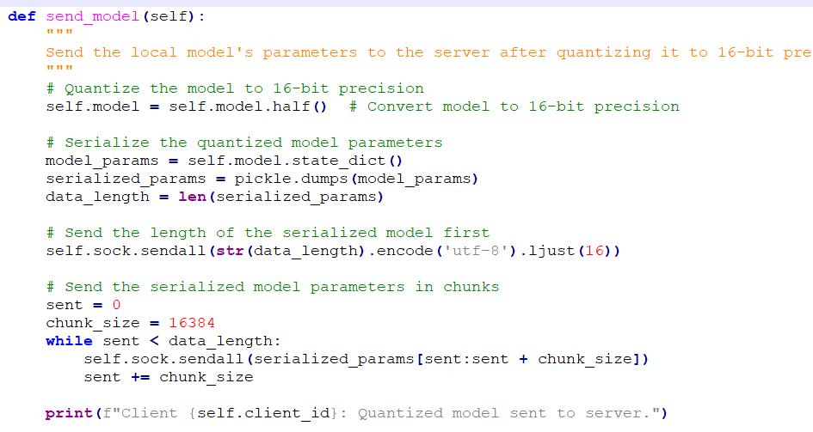
Using the Quantization Technique
Client.py

Slide 12
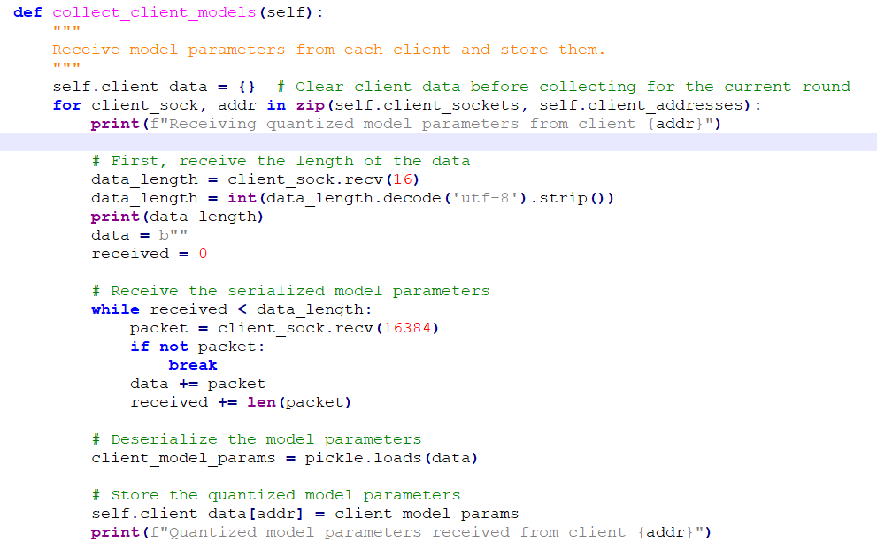

Using the Quantization Technique
Server.py

Slide 13
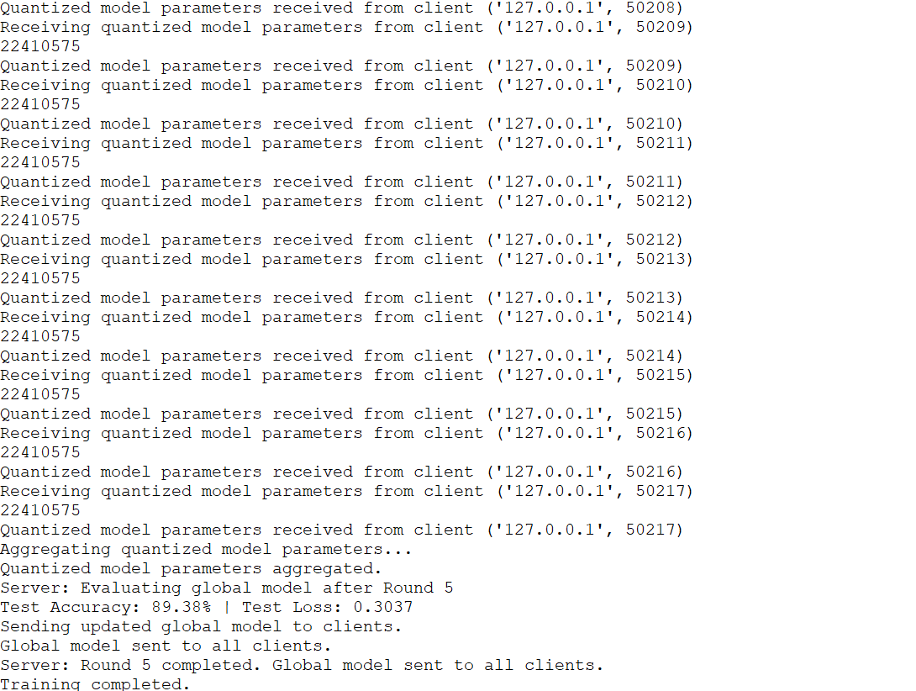
Results: Before Attack

Slide 14
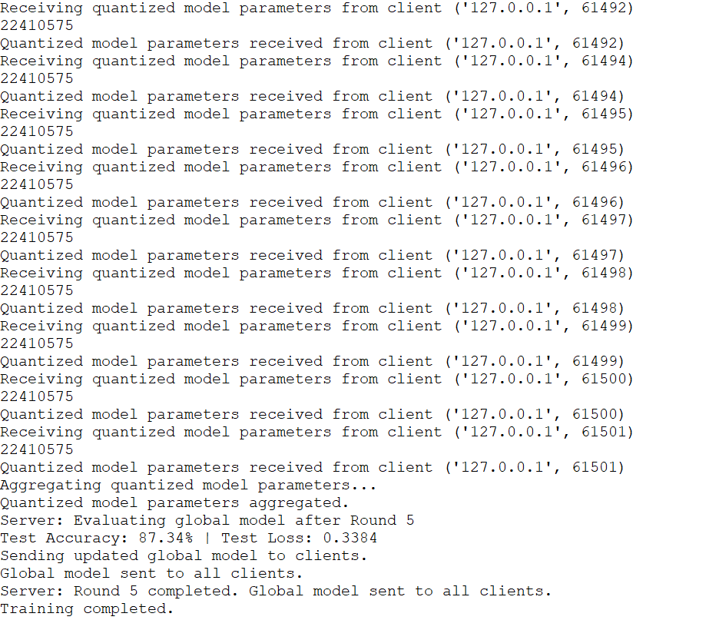
Results: After Attack

Slide 15
Plan of Action
Using the adversarial dataset made, train the model with both original and adversarial datasets.
This training makes the model more robust towards adversarial attacks.
But also reduces the accuracy on clean examples(~10%).

Slide 16
THANK YOU

